Slide 1
Procedurally Generated Voxel Landscape
Group 16 - Computer Graphics
Lecturer: Dr. Nguyen Hoang Ha

Slide 2
Our members
Văn Quốc An BI11-004
Phạm Minh Hiếu BI11-090
Hoàng Quang Huy BI11-111
Lê Đình Thông BI11-257

Slide 3
Agenda
Introduction
Methods
Results and Demo

Slide 4
01 Introduction

Slide 5

01
Introduction
A super popular franchise, with building blocks and active interaction

Slide 6
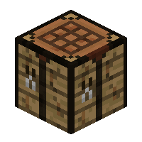
01
Introduction

Slide 7
01
Introduction
Mathematics background
Linear algebra
Geometry mathematics
Programming background and dependencies
Python v3.8
Pyglet v2.0.5
OpenGL v3.3

Slide 8
01
Introduction
References:
Minecraft clone in Python tutorial series
What we change from the tutorial:
Customizatiable speed and sensitivity of mouse and keyboard interaction
Changing between block types by pressing scrolling button of mouse
New chunk generation algorithms: perlin noise
Algorithms for voxel loading
Add double buffer to eliminate shuttering
Merging code between original and new code

Slide 9
02 Methods

Slide 10
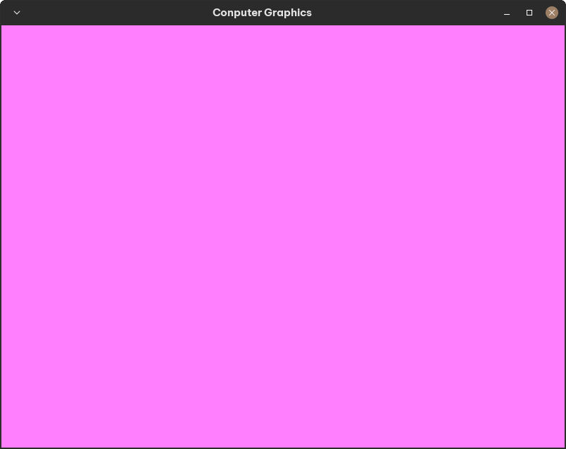
02
Methods
2.1. Creating the window

Slide 11
02
Methods
2.2. Add VAOs, VBOs & IBOs
Vertex Array Objects (VAO)
Vertex Buffer Objects (VBO)
vertex data
index
0 | Positions
1
2
3
…
1
Index Buffer Object (IBO)
positions
2
colors
3
…
Reusable

Slide 12
02
Methods
2.3. Add Shaders
VBO
Vertex Shader
Fragment Shader
Positions
vert_shader
Colors
frag_shader
Output:
vert.glsl
frag.glsl
glsl: GL Shading Language
- high-level shading language
- create effects for 3D graphics

Slide 13
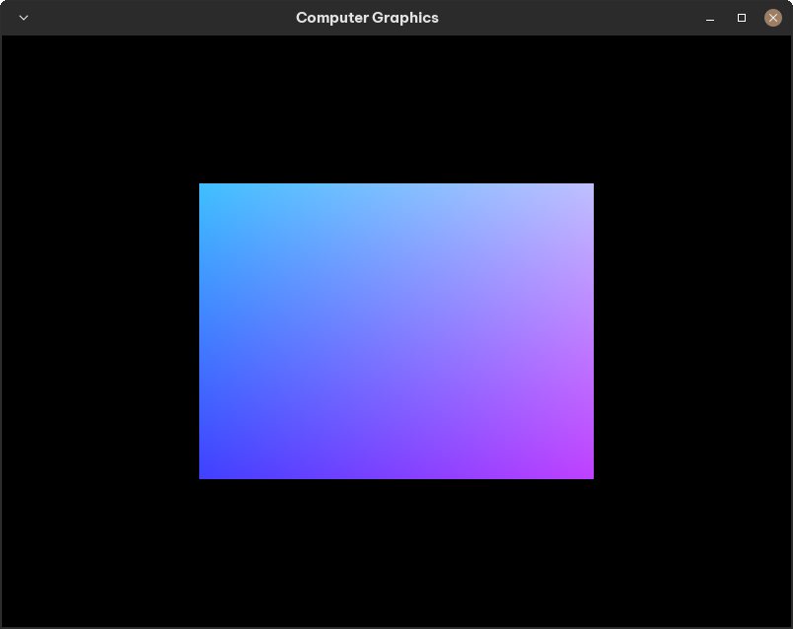
02
Methods
2.3. Add Shaders

Slide 14
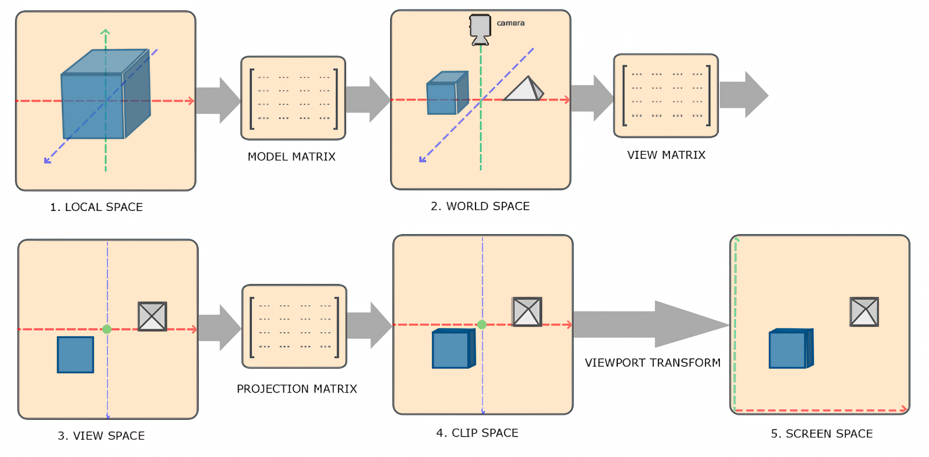
02
Methods
2.4. Make 3D depth

Slide 15
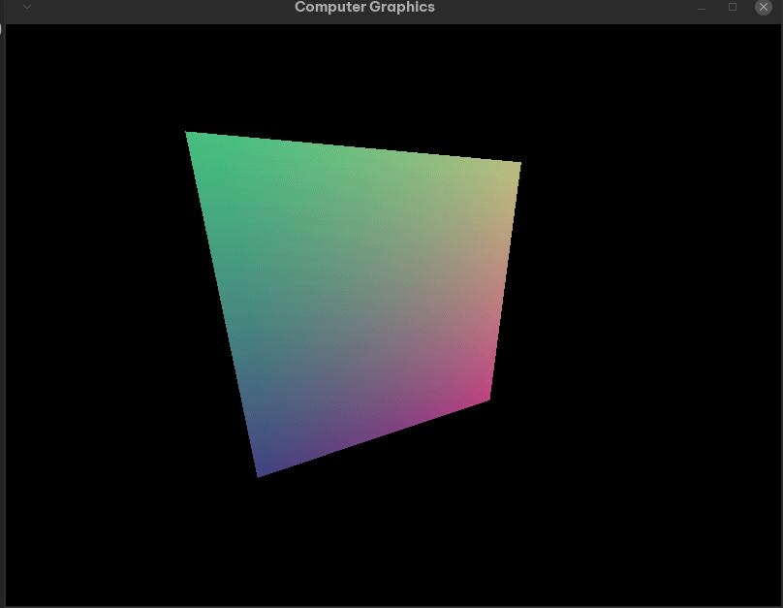
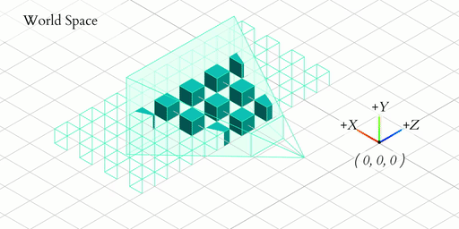
02
Methods
2.4. Make 3D depth

Slide 16





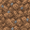









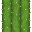
02
Methods
2.5. Create texture and blocks
Faithful Resource Pack

Slide 17
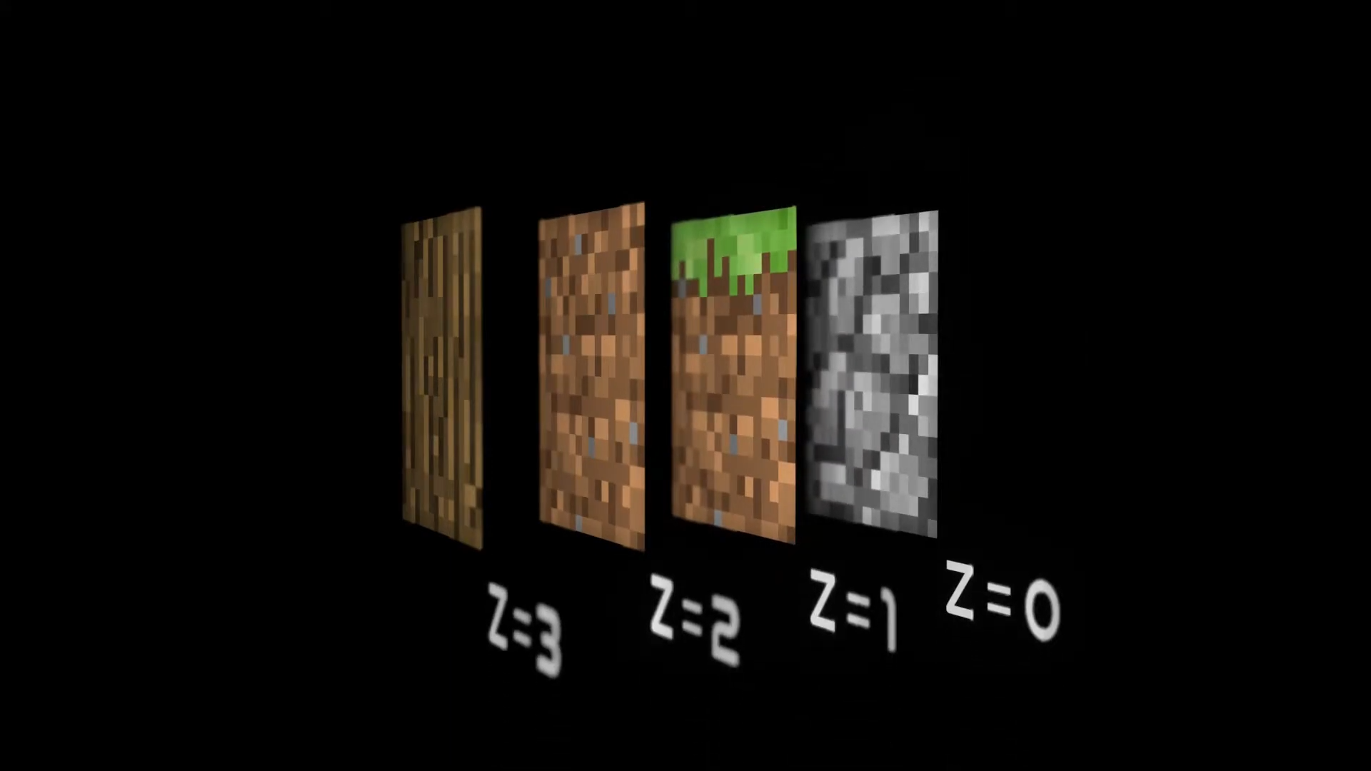
02
Methods
2.5. Create texture and blocks
Texture array

Slide 18
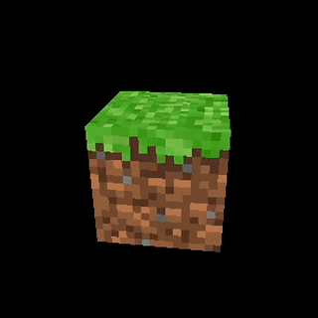
02
Methods
2.5. Create texture and blocks
Texture array manager

Slide 19
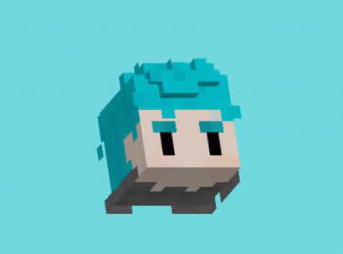
02
Methods
2.6. Handling input
+z
+y
-x
+x
-z
+z
-z
-y

Slide 20
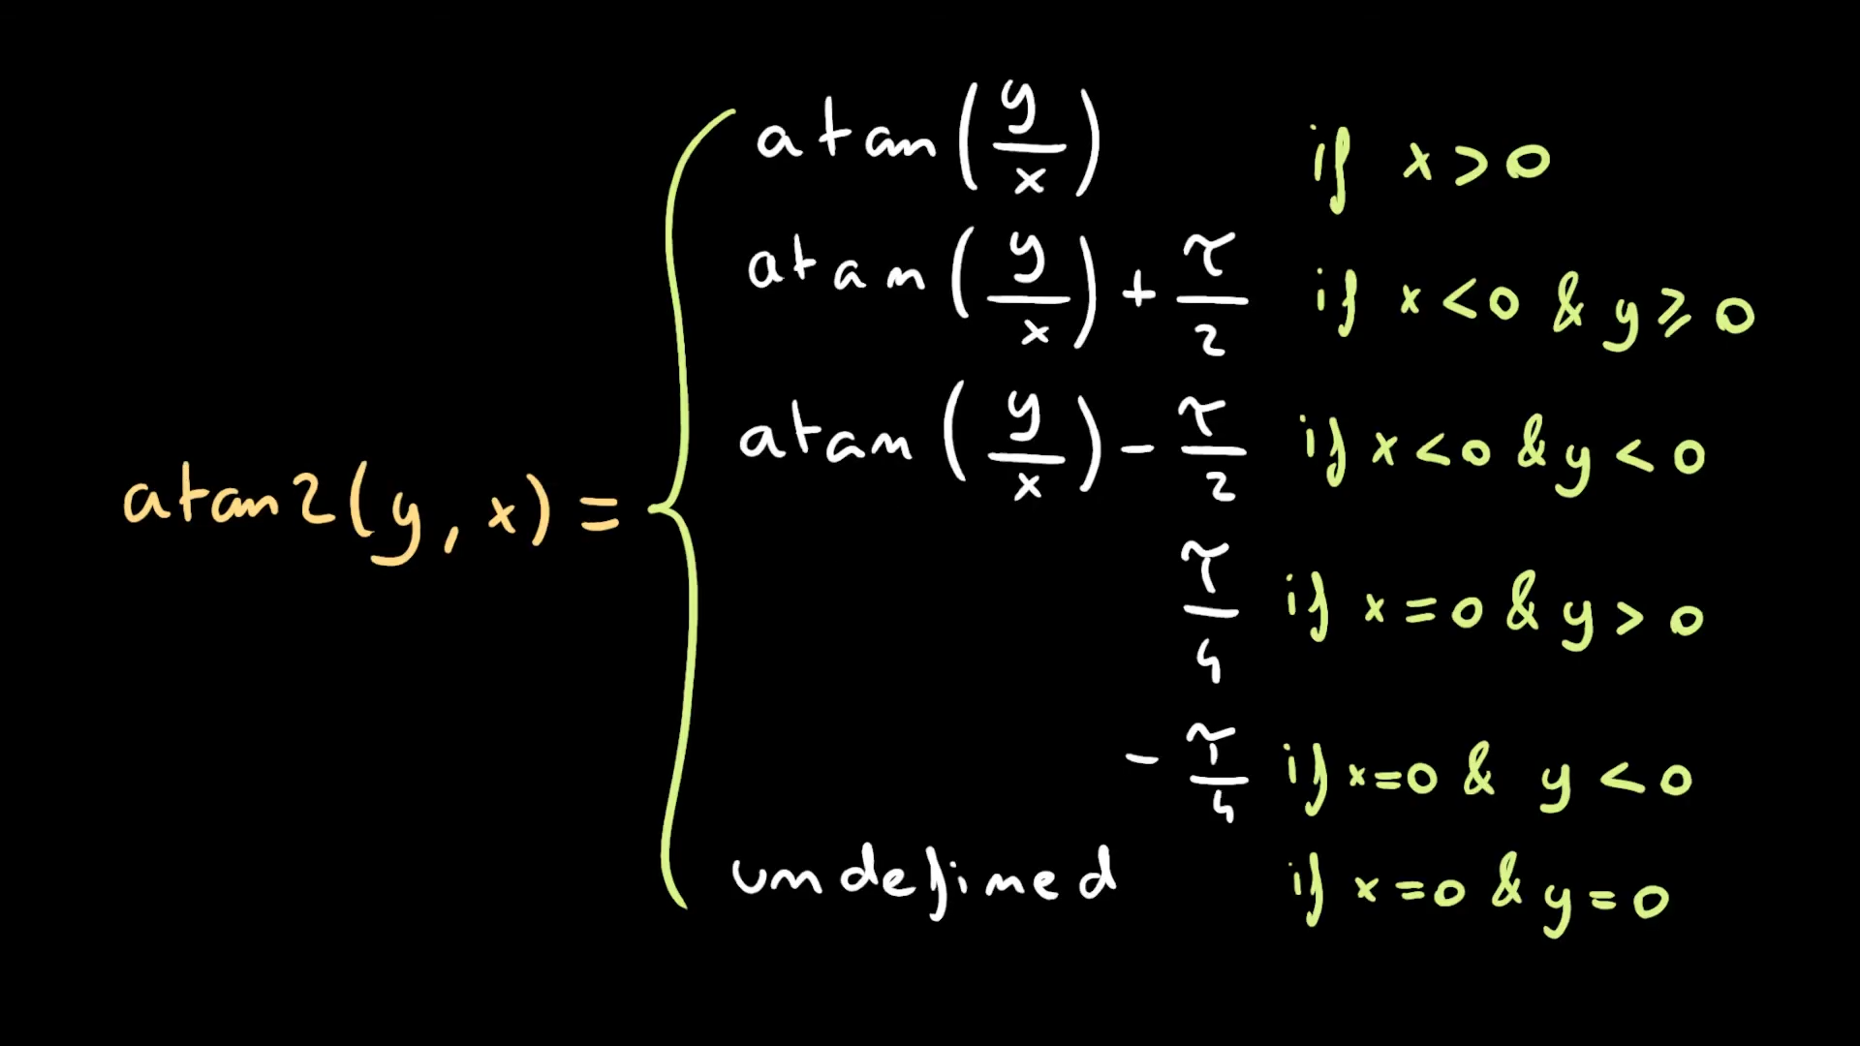
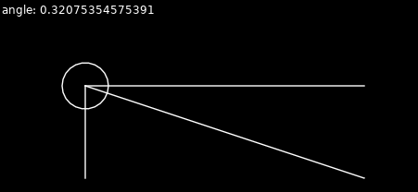
02
Methods
2.6. Handling input

Slide 21
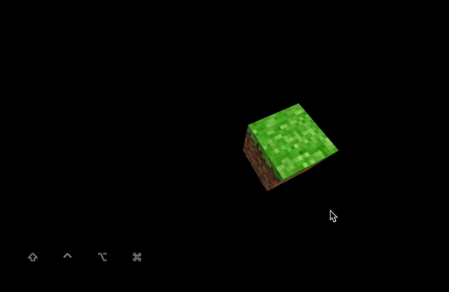
02
Methods
2.7. Shading and Illumination
This is the demo of keyboard interaction with lightning from different direction

Slide 22
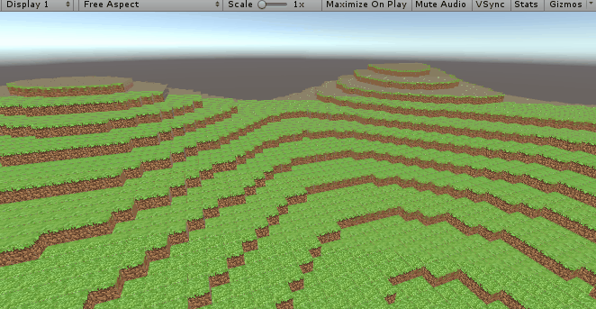
02
Methods
2.8. Chunk Generation
- A technique used in games like Minecraft to divide the world into manageable pieces
- Uses a noise function to create the terrain and features of each chunk

Slide 23
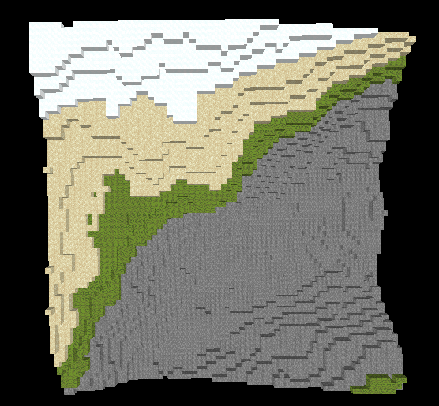
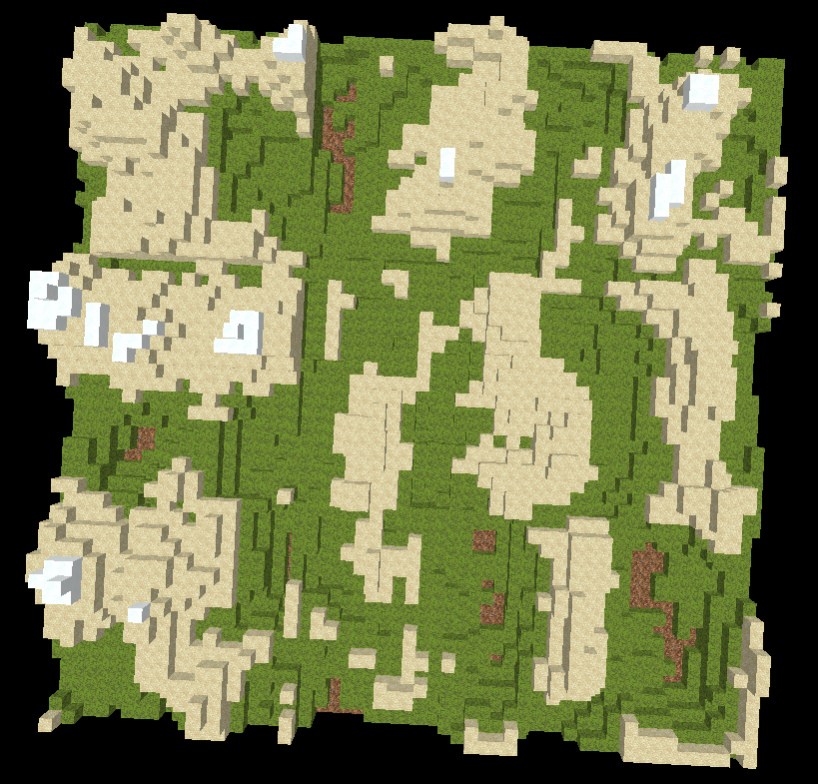
02
Methods
2.8. Chunk Generation
- A technique used in games like Minecraft to divide the world into manageable pieces
- Uses a noise function to create the terrain and features of each chunk

Slide 24
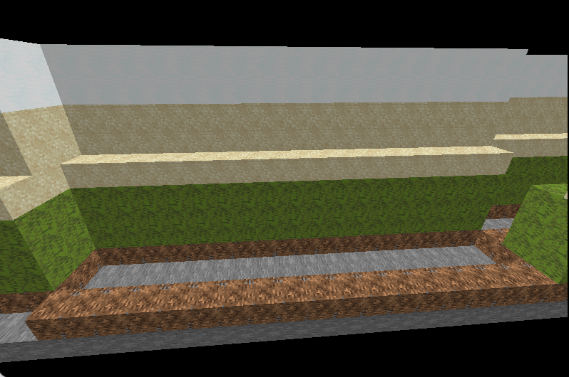
02
Methods
2.8. Chunk Generation
- Perlin noise function
- A chunk includes 18*18*10*9 blocks
- 9 voxels, randomly selected blocks
+ Rock: 1 layer
+ Earth:1 layer
+ Grass: 2 layer
+ Sand: 3 layer
+ Snow: 2 layer

Slide 25
03 Result and Demo

Slide 26
03
Results and demo
3.1. Result
- Requirements acquired:
Texturing and coloring
Keyboard and mouse interaction
Bump mapping
Shader (replace for lightning)
Surface

Slide 27
03
Results and demo
3.2. Demo

Slide 28
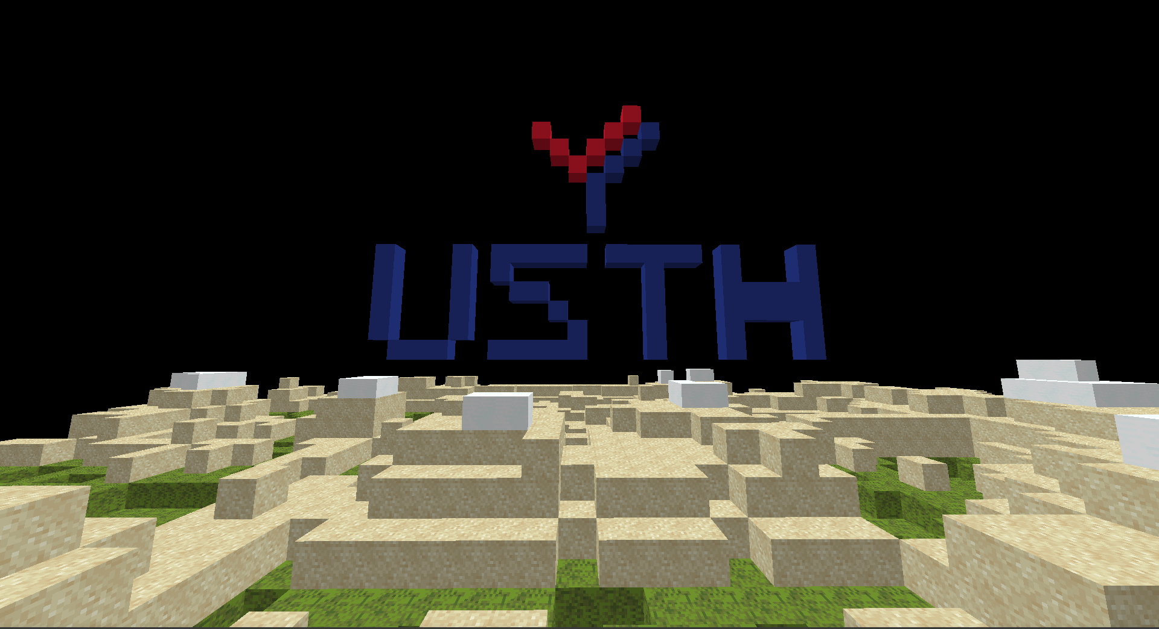
Thank You!
Any questions?

